Slide 1
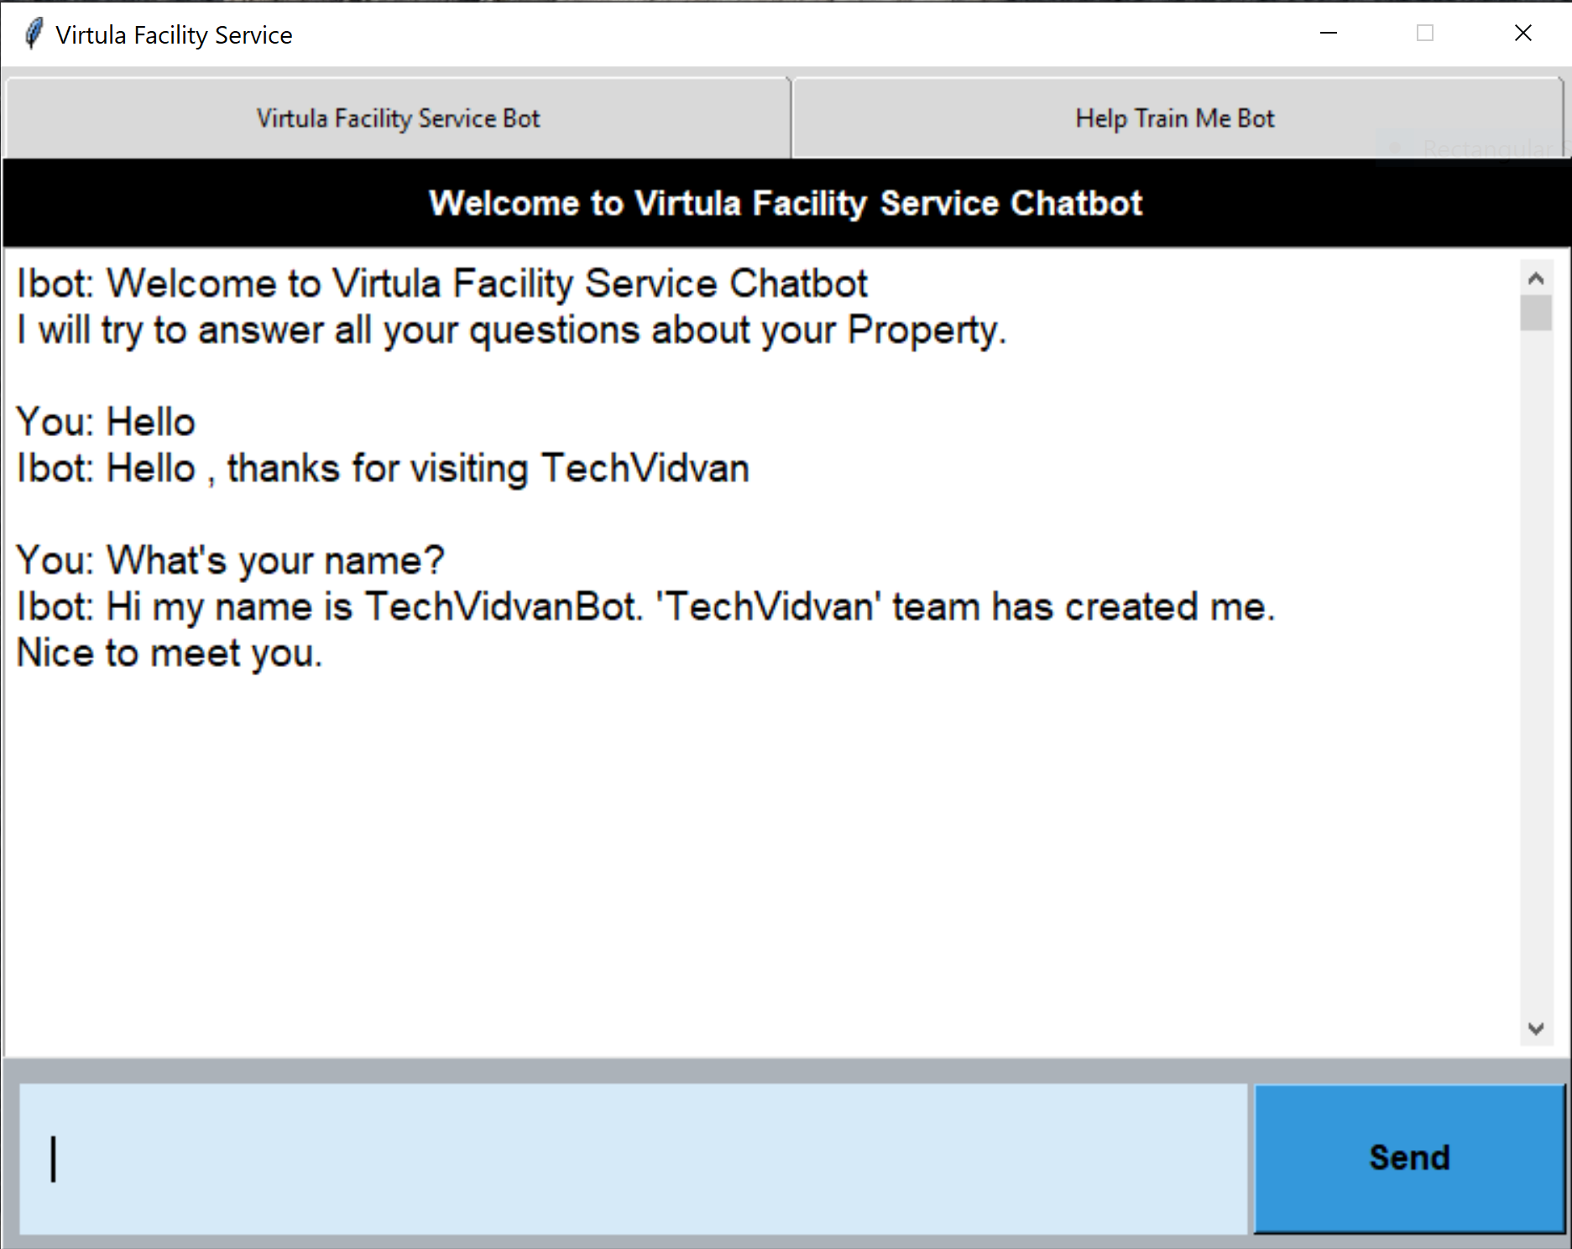
Virtual Facility Service Chatbot
By: Yousof Rahimian
Notes:
Hi, my name is Yousof Rahimian and today we are going to talk about a Virtual Facility Service Chatbot.

Slide 2
What do I need to start?
Can anyone do it?
How to find the experts painter?
Do I need special tools?
Notes:
When you are first learning a hobby, you have a lot of questions.
Some go to classes, some go to books, and some go online to find answers.
The problem arises when a student goes home from a class or reads a book or blog, they still have questions.
This chatbot is aimed to help consolidate a lot of questions the user may have into a learning environment where the chatbot can help answer those questions.

Slide 3
{
"intents": [
{
"tag": "greeting",
"patterns": [
"Hi",
"Hello",
"Hey"
],
"responses": [
"Hello",
"Hi",
"How are you?"
]
},
{
"tag": "goodbye",
"patterns": [
"Bye",
"See you later",
"Goodbye"
],
"responses": [
"See you!",
"Have a nice day!",
"Bye"
]
},
Tag: topics that a user may query about
Intents.json: initial data for the model to learn from
Patterns: queries that a user may ask about a tag
Responses: static responses that will be used for answers to the queries about the tags
Data
Notes:
For the chatbot to learn, initial data needs to be created.
For this chatbot, the data was created from gathering questions people had on Google and social media.
With the data I gathered an intents.json file was created.
The intents.json file is used to initially train the model.
Tags are like topics that a user may have a question about.
Patterns are the questions that a user may ask about that tag or topic.
Responses are what the chatbot will answer with about the specific tag. There can be multiple responses to the same tag and the chatbot will randomly choose a response.

Slide 4
Training
Intents
{
"tag": "greeting",
"patterns": [
"Hi",
"Hello",
"Hey"
],
"responses": [
"Hello",
"Hi",
"How are you?"
]
},
Words
Classes
[',', '50/50', '60/40', 'a', 'anyone', 'are', 'artistic', 'awesome', 'be', 'beginner', 'best', 'break', 'buy', 'bye', 'can', 'circle', 'cool', 'copper', 'curve', 'cut', 'cutting', 'decorative', 'diamond', 'do', 'doe', 'dot', 'fit', 'fitting', 'flux', 'fluxing', 'foil', 'for', 'get', 'glass', 'go', 'good', 'goodbye', 'grinder', 'have', 'hello', 'here', 'hey', 'hi', 'hole', 'how', 'i', 'in', 'into', 'intricate', 'is', 'jewelry', 'kind', 'later', 'line', 'measurement', 'moon', 'my', "n't", 'name', 'need', 'not', 'of', 'off', 'on', 'paint', 'peal', 'piece', 'place', 'pretty', 'saw', 'score', 'see', 'should', 'size', 'solder', 'soldering', 'splinter', 'stained', 'start', 'sticking', 'supply', 'talent', 'taurus', 'thank', 'thanks', 'the', 'there', 'this', 'to', 'trying', 'use', 'wavy', 'we', 'what', 'whats', 'when', 'where', 'who', 'why', 'window', 'with', 'you']
['breaks', 'circle', ‘paint', 'decorative', 'drilling', 'flux', ‘roofing', 'goodbye', 'greeting', 'grinder', 'measurements', 'moon', 'name', 'occupation', 'paint', 'saw', 'shopping', 'skill', 'solder', 'splinters’, ‘plumbing', 'supply', 'thanks']
Model
Notes:
Before we can train this data, we first process the tags and patterns. This involves creating a vocabulary of words from the patterns – which is called tokenizing.
We will also take the tags and create classes. Basically, taking all the tags and putting into one list.
Once we have the words and classes, we take our patterns and feed them into our model and output the class respective to those patterns.

Slide 5
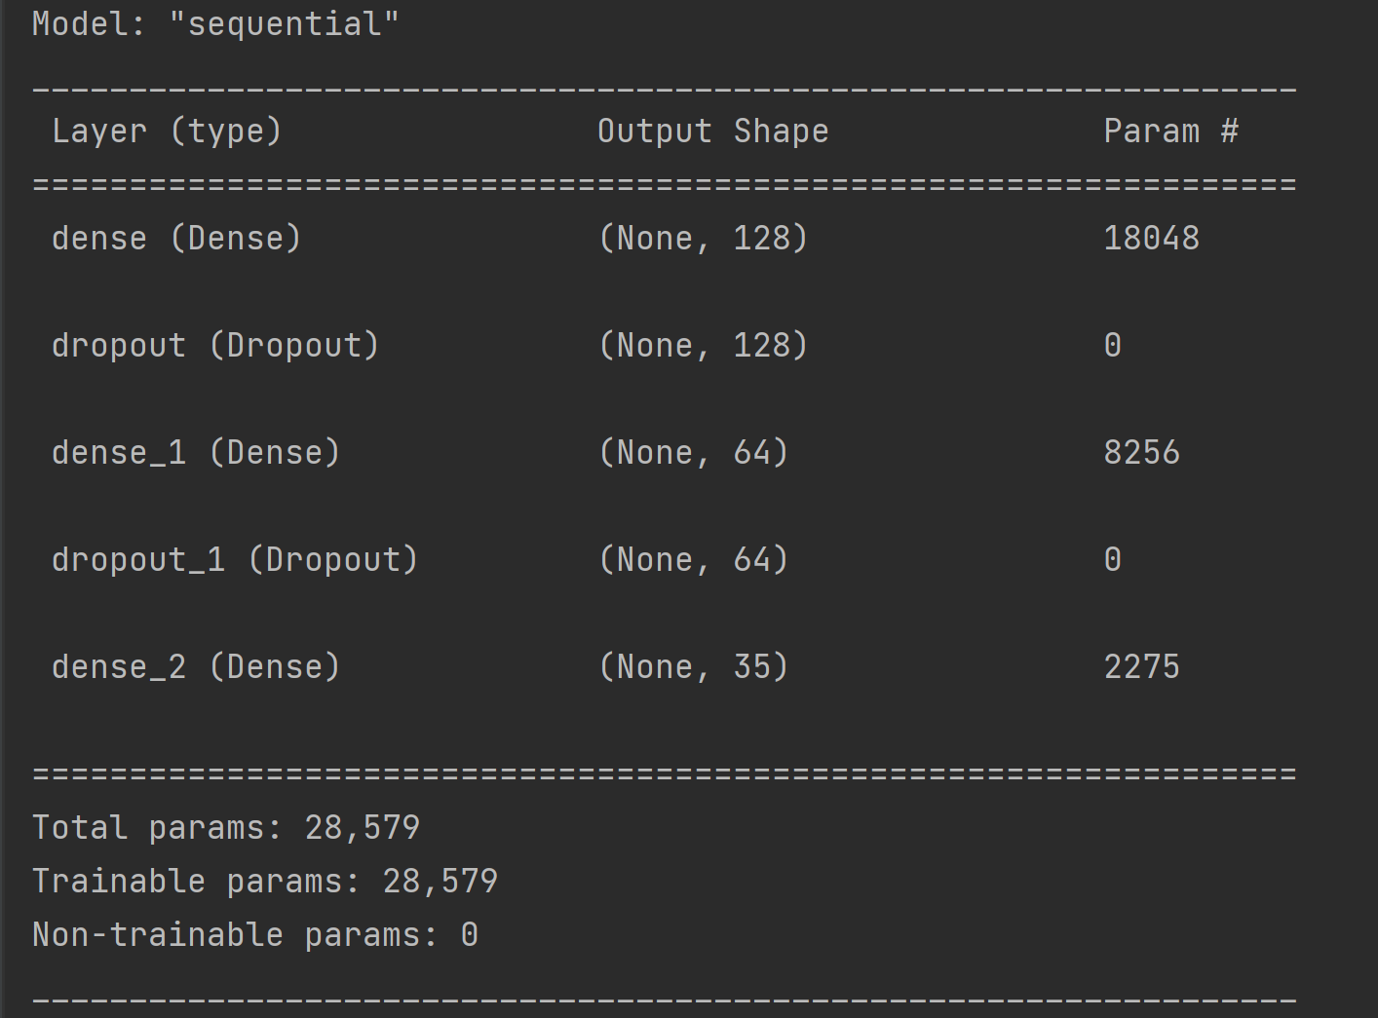
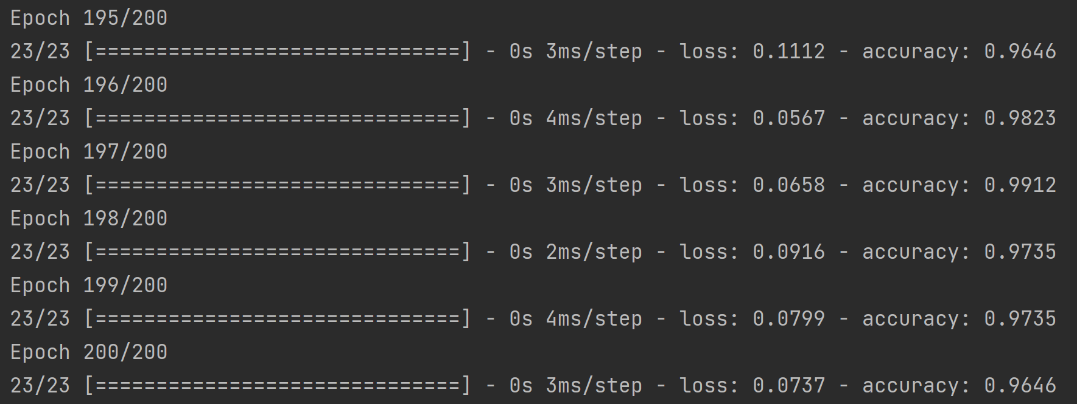
Analysis
Notes:
The model was built using the Sequential class in Tensorflow’s Keras. It has 3 layers and uses some dropout layers to help with overfitting the data between the layers.
The model trained 28,579 words and after 200 epochs (or full passes over the training data) we got down to a loss value of 0.0315 and 99% accuracy (although this may slightly change each time the model is retrained).
The lower the loss value and closer to 0, the closer the predictions are to the true tags.
The model is then saved for the chatbot to use.

Slide 6
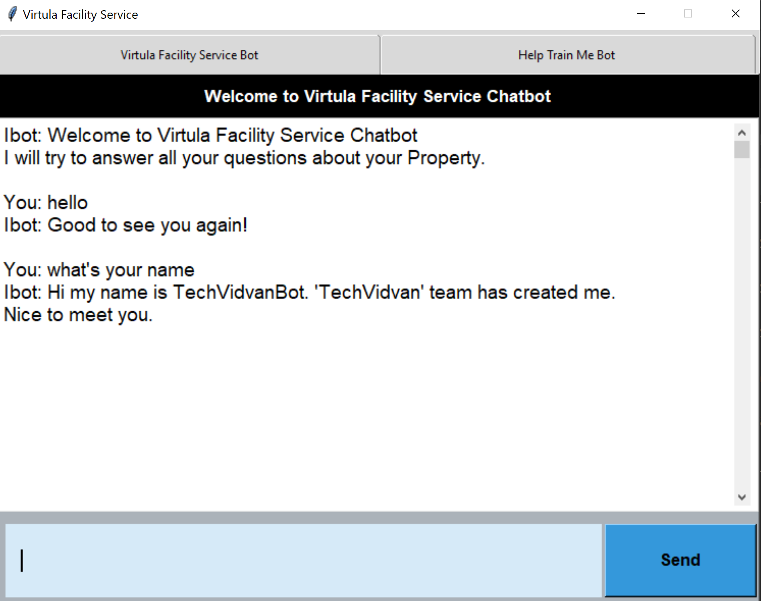
Testing
[('greeting', '0.99946314')]
{
"intents": [
{
"tag": "greeting",
"patterns": [
"Hi",
"Hello",
"Hey"
],
"responses": [
"Hello",
"Hi",
"How are you?"
]
},
Notes:
After the Analysis of the model, we are ready to begin the testing phase.
The testing phase is really the user using the chatbot to ask questions to see if we get the appropriate answers.
Let’s go through the example we have here
The first question is basically “Hi”
The response we got was “How are you” back.
The chatbot correctly found with a probability of 99.9% the tag “greeting”
As you can see in the intents.json file the tag “greeting” had the patterns “hi”, “hello” and “hey”. From this you can see why the chatbot found the correct tag with such a high probability.

Slide 7
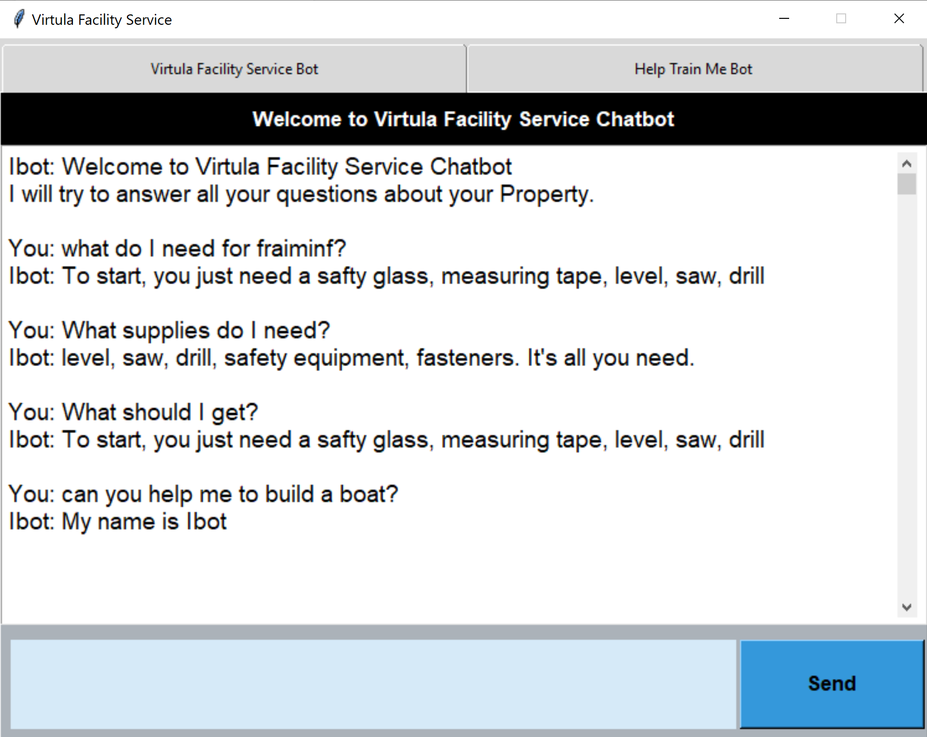
Testing
[('supply', '0.92462075')]
{
"tag": "supply",
"patterns": [
"What supplies do I need?",
"What do I need for fraiming?",
"supplies",
"What does a beginner need?",
"What should I get?",
"supplies",
"How do I start?"
],
"responses": [
"At Lumber, nails, screws, framing hammer, framing square, measuring tape.","level, saw, drill, safety equipment, fasteners. It's all you need.","To start, you just need a safty glass, measuring tape, level, saw, drillfid"
]
},
Notes:
In the next question “what do I need for fraiming”
The chatbot correctly responded with “To start, you just need a safety glass, measuring tape, level, saw, drill”
It correctly predicted the tag “supply” with a 92.5% probability.

Slide 8
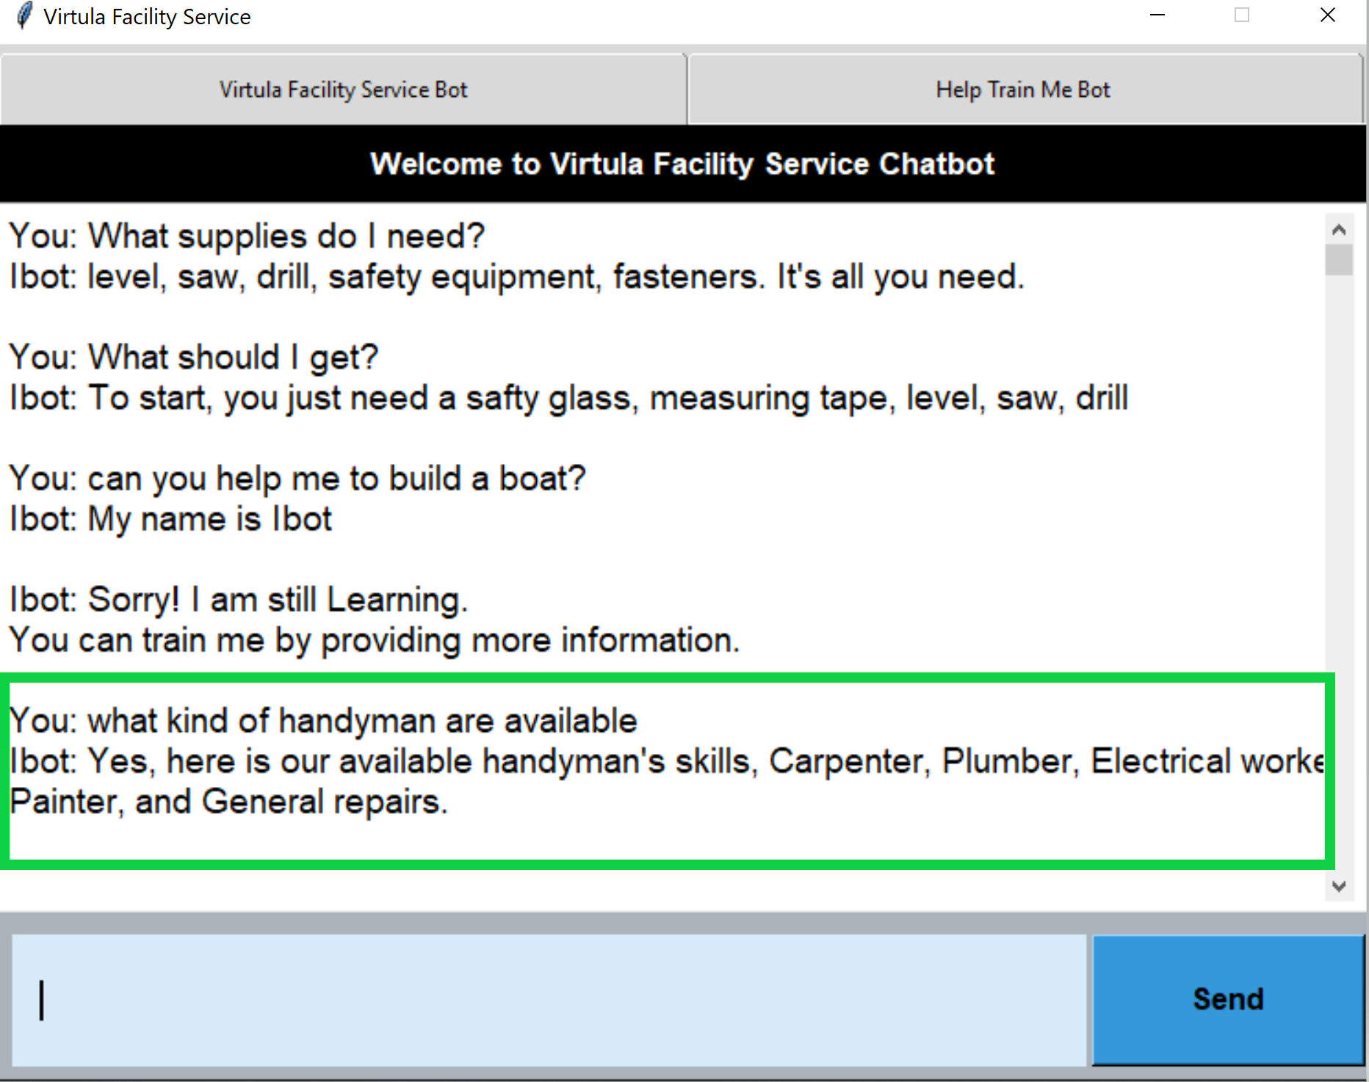
Testing
[('skill', '0.92427206')]
{
"tag": "skill",
"patterns": [
which kind of the handyman skills are available??", "Do you have any handymen?", "what handy man are available?“, "artistic"
],
"responses": [
"Yes, here is our available handyman's skills, Carpenter, Plumber, Electrical worker, Painter, and General repairs.“
]
}
Notes:
In this next question “what kind of handyman are available?”
The chatbot incorrectly predicted the tag “skill” with a 92.4% probability.
Here the user could go into the training bot tab a help retrain the chatbot about flying to the moon.

Slide 9
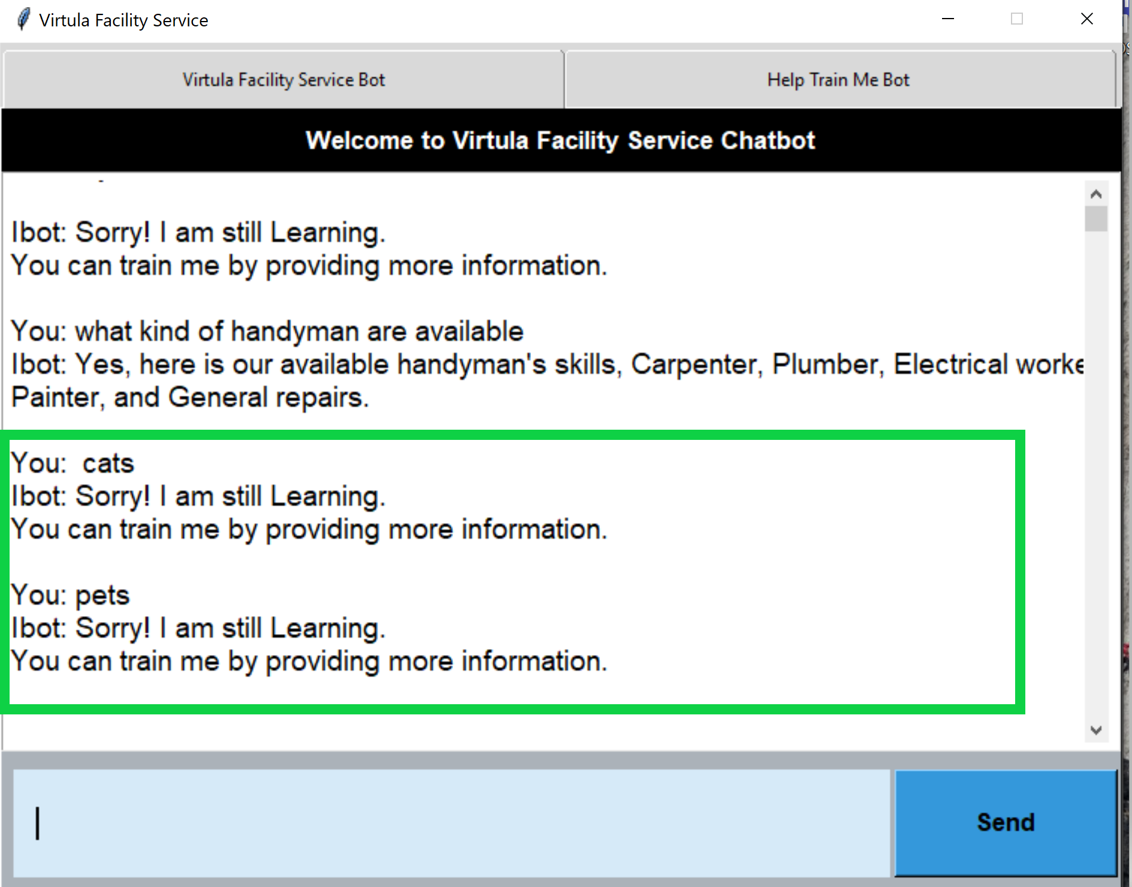
Testing
Notes:
Lastly in the statement cats and petd. The chatbot correctly couldn’t predict with a probability over 50% the correct response so it answer with the default response of “Sorry, I am still learning. You can train me by providing more information”
This will allow the user to either rephase their question or go to the training bot tab to train the chatbot further about dogs (if this was a real stained glass question)

Slide 10
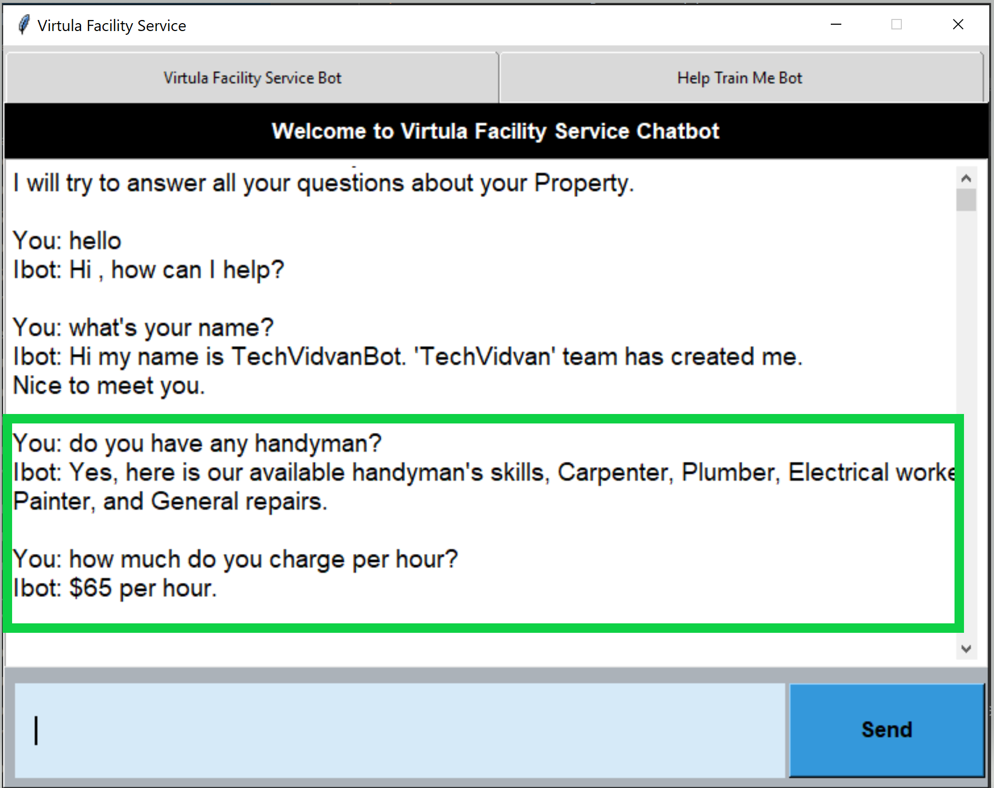
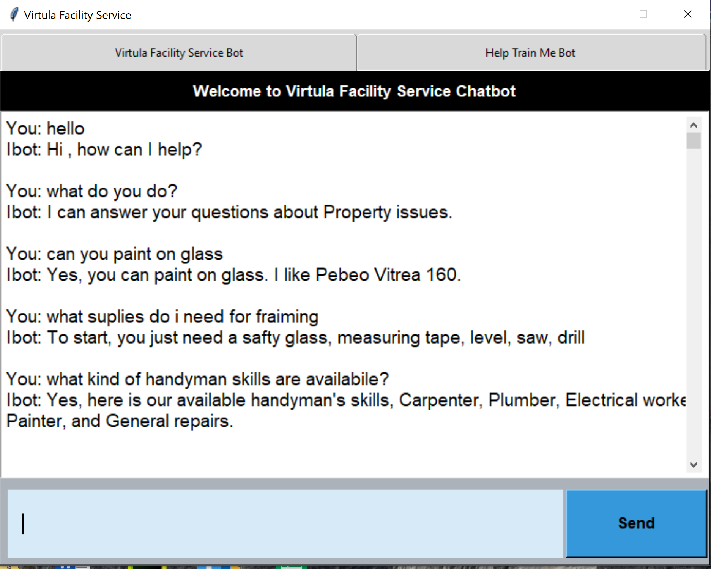
Conclusion
Notes:
Although this is a very primitive version of what a chatbot should be, it answers questions to the best of its ability (as any normal human would).
As users input more of their expertise into the training tab, the model will be able to have a broader and more decisive model to draw from so as time goes on the chatbot will be a good tool for any beginning-Virtual Facility Service .

